Slide 1
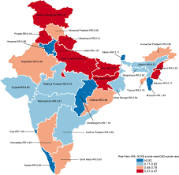
Analysis of suicide CASES IN INDIA
Submitted to :
Alwyn Micaiah
Submitted by :
REDON N ROY
MEENAL SHREE
NEHA KUMARI
NIROSHA M

Slide 2
DESCRIPTION
The aim of our project is to analyze the data of suicide cases in India during the period 2001-2012.
The aim is to make an analysis of suicide rates and different reasons due to which people have committed suicide in India. It is very important to understand the reason to commit suicide and Data Science helps in this regard.
The current report reviews the data from the series of suicides in India by various parameters during the period 2001-2012.

Slide 3
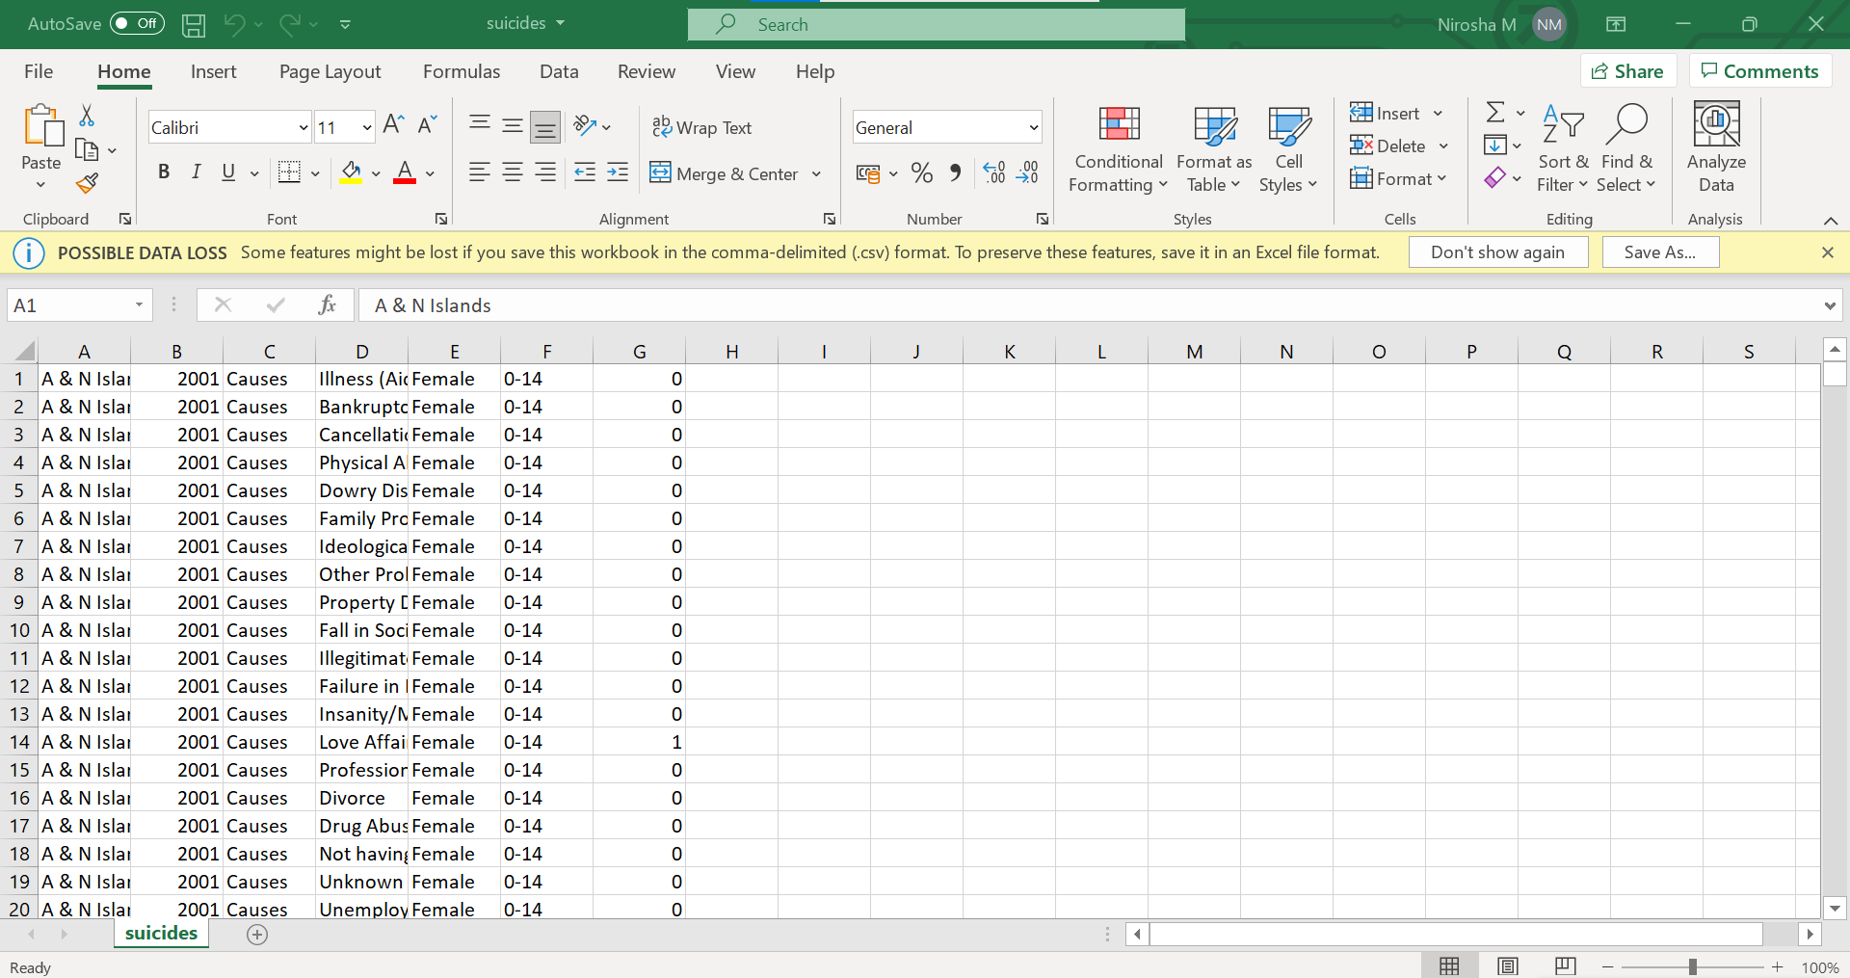
DATA DESCRIPTION
Data refers to State/UT-wise distribution of suicide deaths by sex and age group due to causes like physical abuse, bankruptcy, divorce, professional etc.
Dataset consists of 237519 rows and 7 columns
Consists information of State, Year, Type, Gender, Age group etc...

Slide 4
TOOLS & Technologies Used
TOOLS :
Hortonworks Sandbox HDP
Ambari
Best suited technologies:
Hive
Apache Spark SQL

Slide 5
commands
HIVE QUERIES
Creating Database :
create database indiaDB;
use indiaDB;

Slide 6
Creating table :
Command : create table suicides(state string,year int, type_code string, type string, gender string, age_group string, case_count int) row format delimited fields terminated by ‘,’ ;
Here we are creating a table with required columns . The input consist of the field separated by the ’ ,’ so we set the delimiter as ‘,’

Slide 7
Loading the data into HIVE table :
Command : load data local inpath '/root/suicides.csv' into table suicides;
Loading the data from the local storage into the hive table

Slide 8
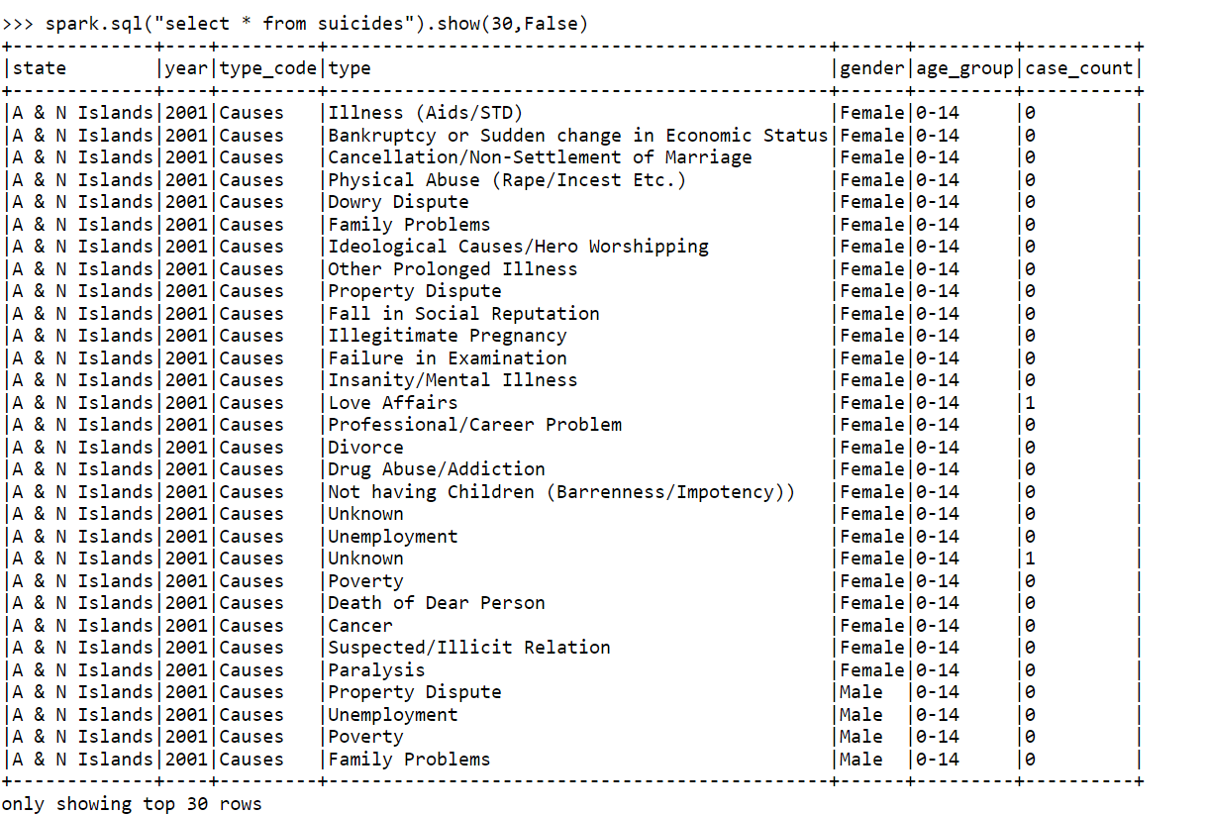
SPARK QUERIES
hc = spark.builder.enableHiveSupport().getOrCreate()
hc.sql("use indiaDB")
data = hc.sql("select * from suicides")
data.show(20,False)
data.createOrReplaceTempView("suicides")
from pyspark.sql.functions import sum,col,min,max
spark.sql("select * from suicides").show(30,False)

Slide 9
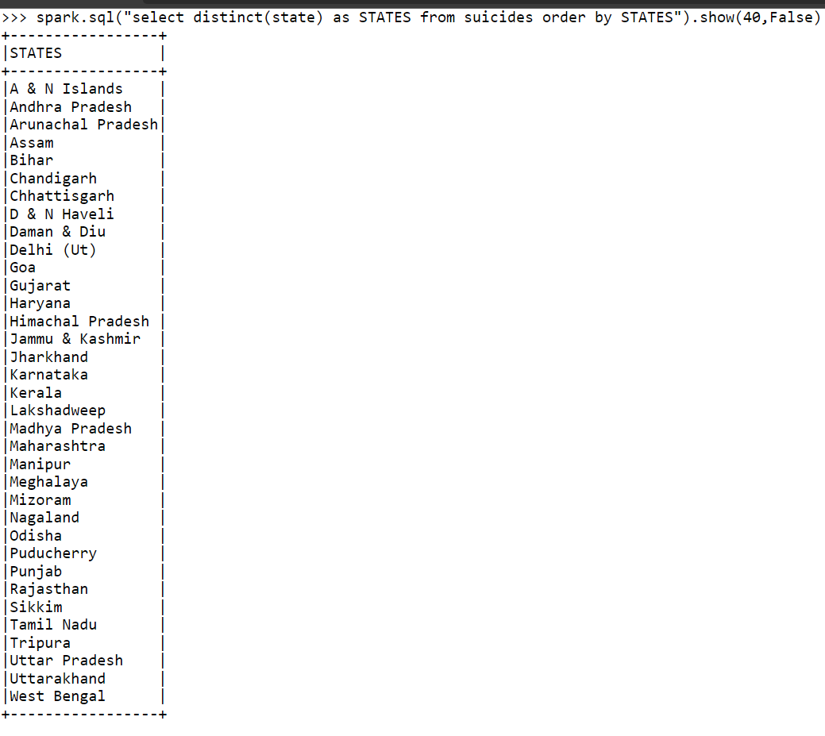
List of states in the dataset
Query: spark.sql("select distinct(state) as STATES from suicides order by STATES").show(40,False)
Explanation:-
We are using the Spark SQL to find the distinct states in the dataset and then displaying them.

Slide 10
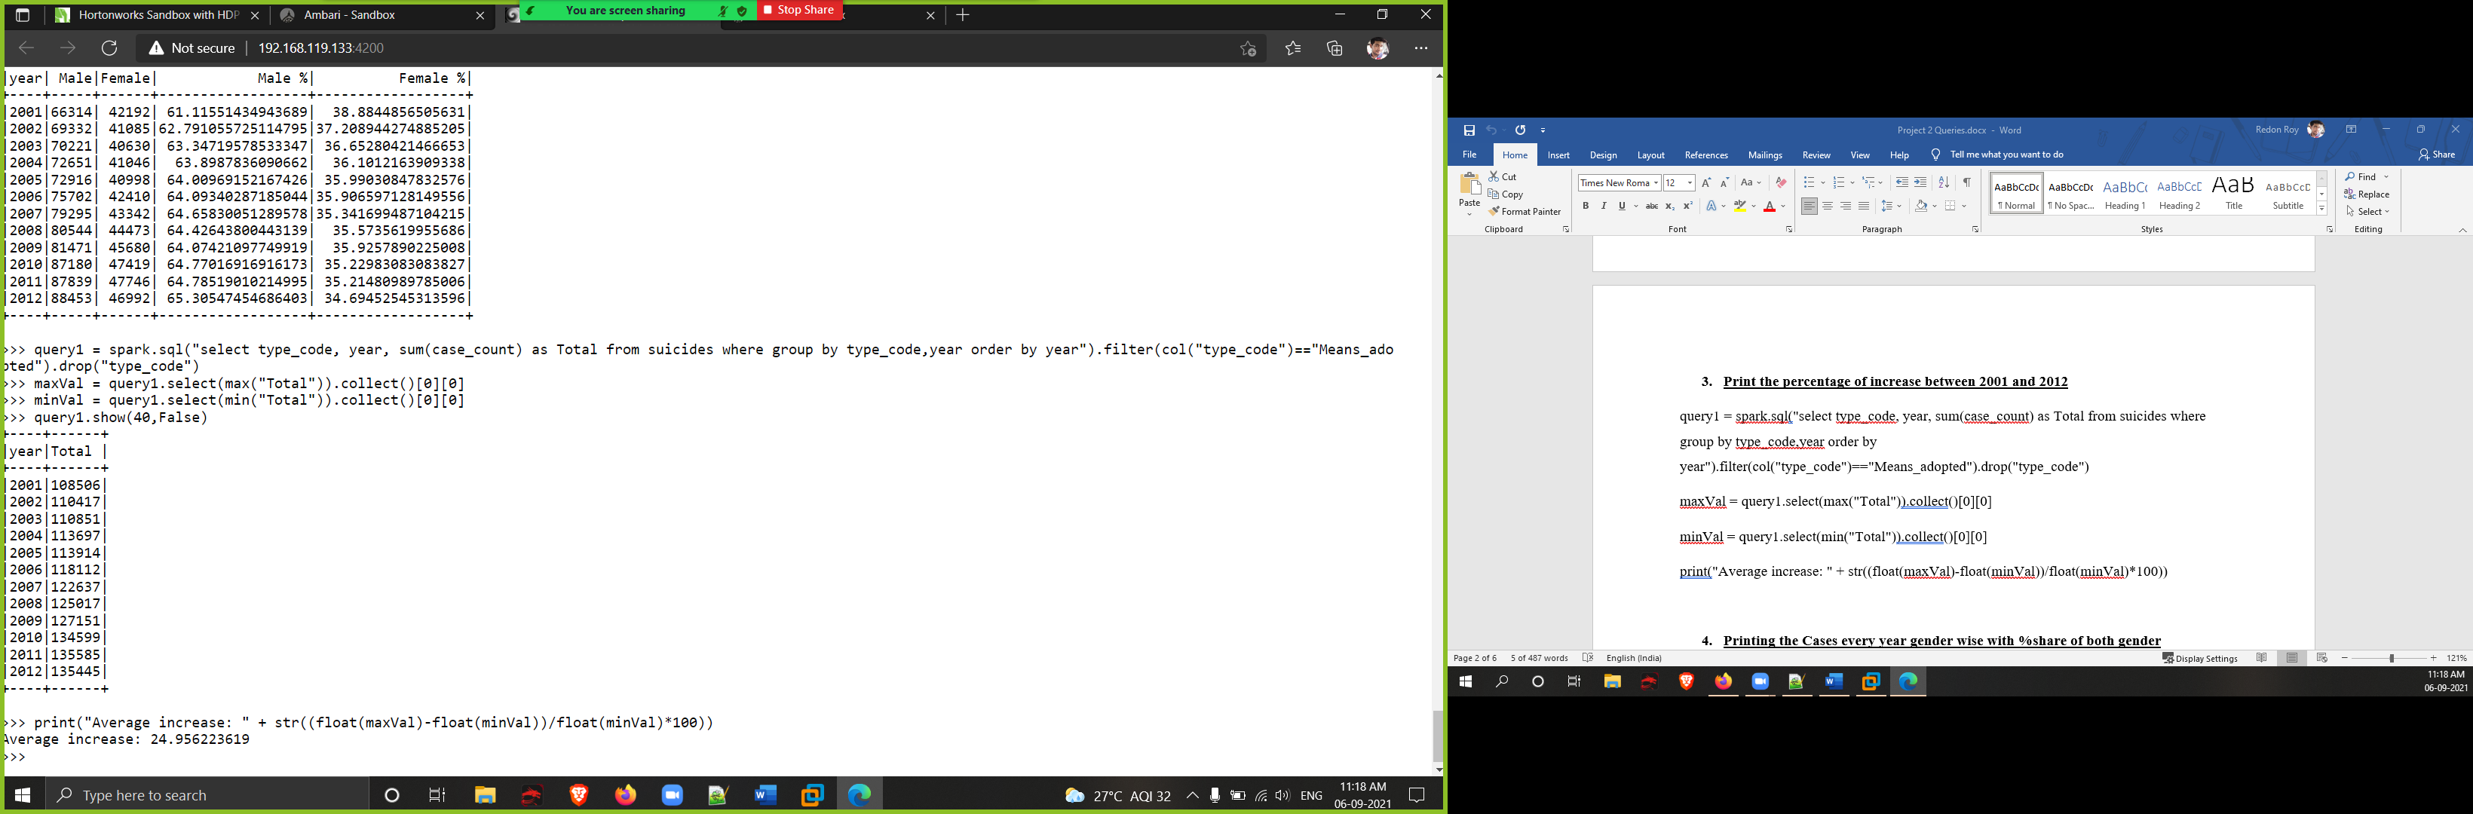
2. Total cases according to the year
Query: spark.sql("select type_code, year, sum(case_count) as Total from suicides where group by type_code,year order by year").filter(col("type_code")=="Means_adopted").drop("type_code").show(40,False)
Explanation:-
Using Spark SQL, we are selecting the type_code, year and sum of case_count from the TempView and filtering it to find the Total cases each year.

Slide 11
3. Percentage of increase between 2001 and 2012
Query: query1 = spark.sql("select type_code, year, sum(case_count) as Total from suicides where group by type_code,year order by year").filter(col("type_code")=="Means_adopted").drop("type_code")
maxVal = query1.select(max("Total")).collect()[0][0]
minVal = query1.select(min("Total")).collect()[0][0]
print("Average increase: " + str((float(maxVal)-float(minVal))/float(minVal)*100))
Explanation:-
We are selecting the max and min values of the total cases each year to find the average increase in suicides.

Slide 12
4. Cases every year gender wise with %share of both gender
Query: maleData = data.filter((data.type_code == "Means_adopted") & (data.gender == "Male")).groupBy("year","gender").agg(sum("case_count").alias("Male")).orderBy("year").drop("gender")
femaleData = data.filter((data.type_code == "Means_adopted") & (data.gender == "Female")).groupBy("year","gender").agg(sum("case_count").alias("Female")).orderBy("year").drop("gender")
genderData = maleData.join(femaleData,"year")
genderData.withColumn("Male %", col("Male")/(col("Male")+col("Female"))*100).withColumn("Female %" ,col("Female")/(col("Male")+col("Female"))*100).show()

Slide 13
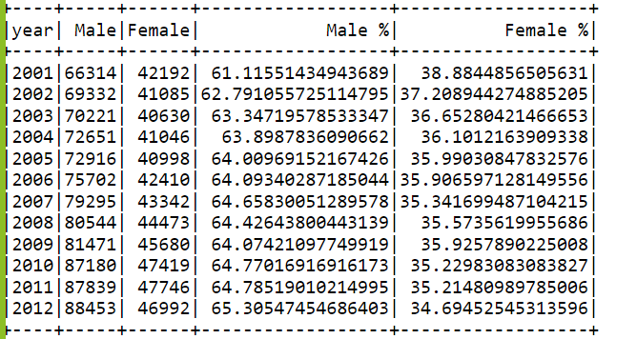
4. Cases every year gender wise with %share of both gender
Explanation:-
First we extracted the total suicides my male each year and the total suicides of females each year from the dataset. The we joined it over the “year” column and finally added two columns representing the percentage share of suicides of male and female for that year.

Slide 14
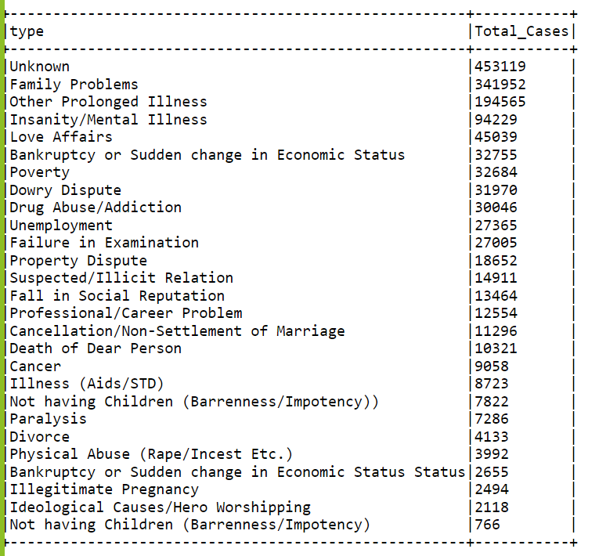
5 . Causes for suicide in descending order of total of cases
Query: data.filter(data.type_code == "Causes").groupBy("type").agg(sum("case_count").alias("Total_Cases")).orderBy(col("Total_Cases").desc()).show(50,False)
Explanation:-
Using dataframe operations, we are finding out the most common cause for suicide from the dataset with the help of filter(), groupBy() and orderBy()

Slide 15
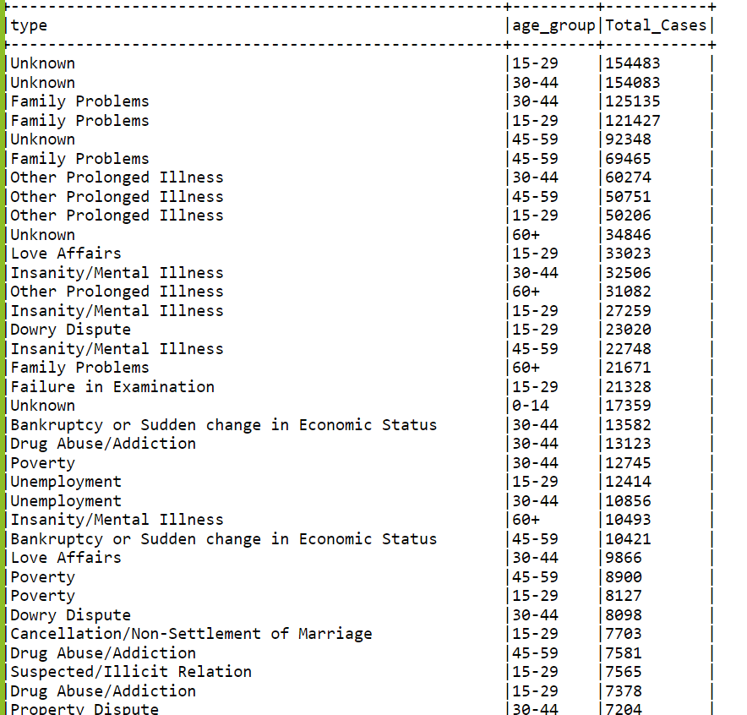
6. Causes for suicide based on age groups in descending order of total cases
Query: data.filter(data.type_code == "Causes").groupBy("type","age_group").agg(sum("case_count").alias("Total_Cases")).orderBy(col("Total_Cases").desc()).show(200,False)
Explanation:-
Using dataframe operations, we are finding out the most common cause for suicide broke done with age groups from the dataset with the help of filter(), groupBy() and orderBy()

Slide 16
7. Total cases categorised under cause of suicide gender wise
Query: maleData = data.filter((data.type_code == "Causes") & (data.gender == "Male")).groupBy("type").agg(sum("case_count").alias("Male")).orderBy(col("Male").desc())
femaleData = data.filter((data.type_code == "Causes") & (data.gender == "Female")).groupBy("type").agg(sum("case_count").alias("Female")).orderBy(col("Female").desc())
genderData = maleData.join(femaleData,"type")
genderData.show(50,False)
Explanation:-
We are extracting the common causes of male suicides and female suicides into separate dataframes. The we are joining the based on the “type” column to get the final output.

Slide 17
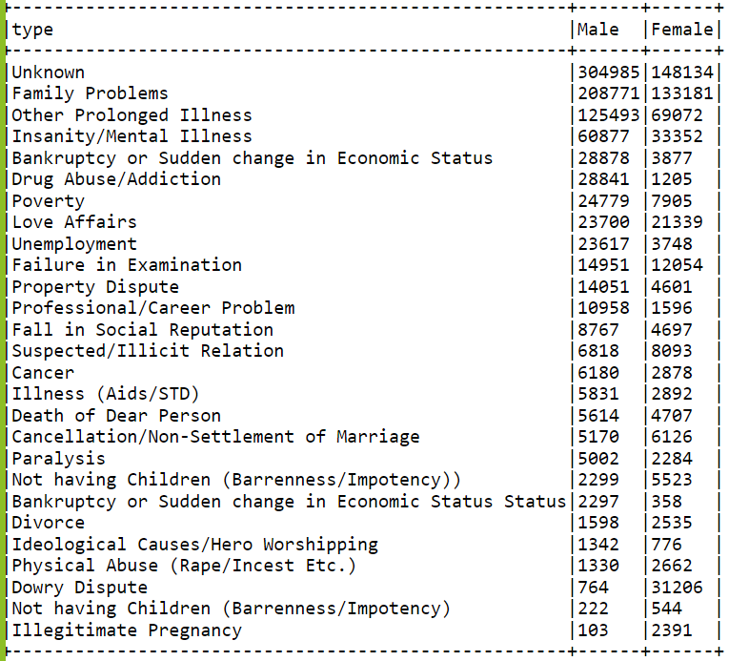
7. Total cases categorised under cause of suicide gender wise

Slide 18
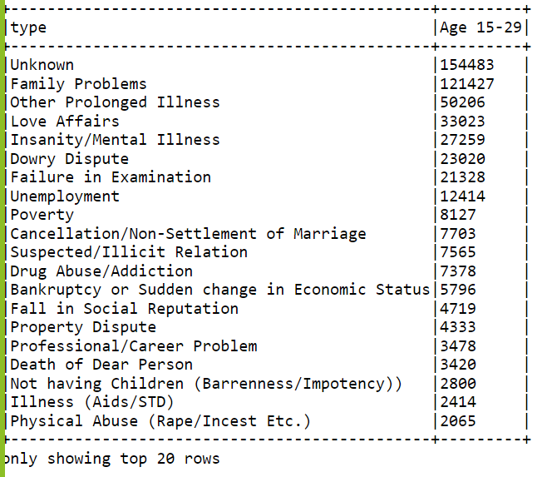
8. Total cases categorised under cause of suicide of specific age group
Query: data.filter((data.type_code == "Causes") & (data.age_group == "15-29")).groupBy("type").agg(sum("case_count").alias("Age 15-29")).orderBy(col("Age 15-29").desc()).show(20,False)
Explanation:-
Using dataframe operations, we are finding out the most common cause for suicide in the age group of “15-29” from the dataset with the help of filter(), groupBy() and orderBy()

Slide 19
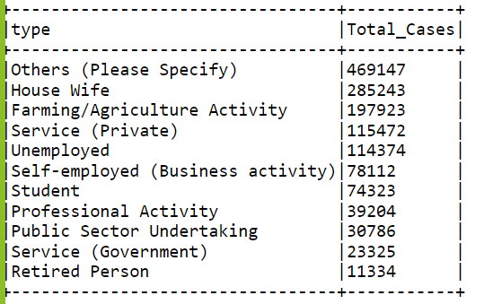
9. Total cases categorised under professional profile of the people who committed suicide
Query: data.filter(data.type_code == "Professional_Profile").groupBy("type").agg(sum("case_count").alias("Total_Cases")).orderBy(col("Total_Cases").desc()).show(50,False)
Explanation:-
Using dataframe operations, we are finding out how many people of each professional profile has committed suicide from the dataset with the help of filter(), groupBy() and orderBy()

Slide 20
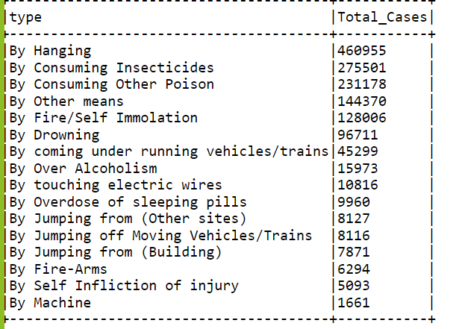
10. Total cases categorised under method adopted for suicide
Query: data.filter(data.type_code == "Means_adopted").groupBy("type").agg(sum("case_count").alias("Total_Cases")).orderBy(col("Total_Cases").desc()).show(50,False)
Explanation:-
Using dataframe operations, we are finding out the most common means adopted to commit the suicides from the dataset with the help of filter(), groupBy() and orderBy()

Slide 21
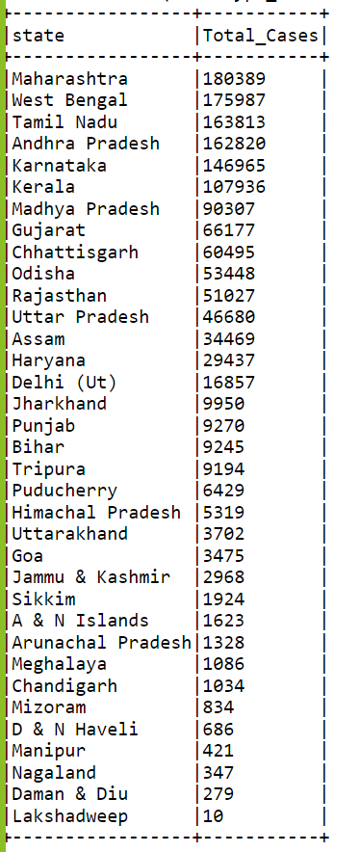
11. Total cases categorised under state
Query: data.filter(data.type_code == "Means_adopted").groupBy("state").agg(sum("case_count").alias("Total_Cases")).orderBy(col("Total_Cases").desc()).show(50,False)
Explanation:-
Using dataframe operations, we are finding out the total number of suicides that has happened in each state from the dataset with the help of filter(), groupBy() and orderBy()

Slide 22
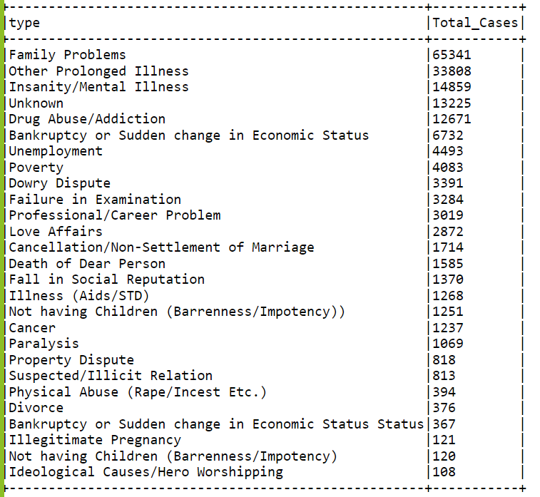
12. Cases on the causes of suicide for a specific state
Query: data.filter((data.type_code == "Causes") & (data.state == "Maharashtra")).groupBy("state","type").agg(sum("case_count").alias("Total_Cases")).orderBy(col("Total_Cases").desc()).drop("state").show(50,False)
Explanation:-
Using dataframe operations, we are finding out the most common cause for suicide of a particular state ( like Maharashtra) from the dataset with the help of filter(), groupBy() and orderBy()

Slide 23
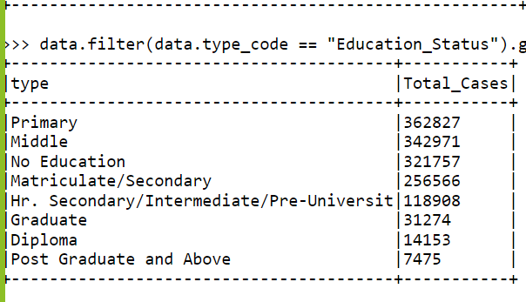
13. Cases on the education status of the people committed suicide
Query: data.filter(data.type_code == "Education_Status").groupBy("type").agg(sum("case_count").alias("Total_Cases")).orderBy(col("Total_Cases").desc()).show(50,False)
Explanation:-
Using dataframe operations, we are finding out the educational qualification of the people who has committed suicide from the dataset with the help of filter(), groupBy() and orderBy()

Slide 24
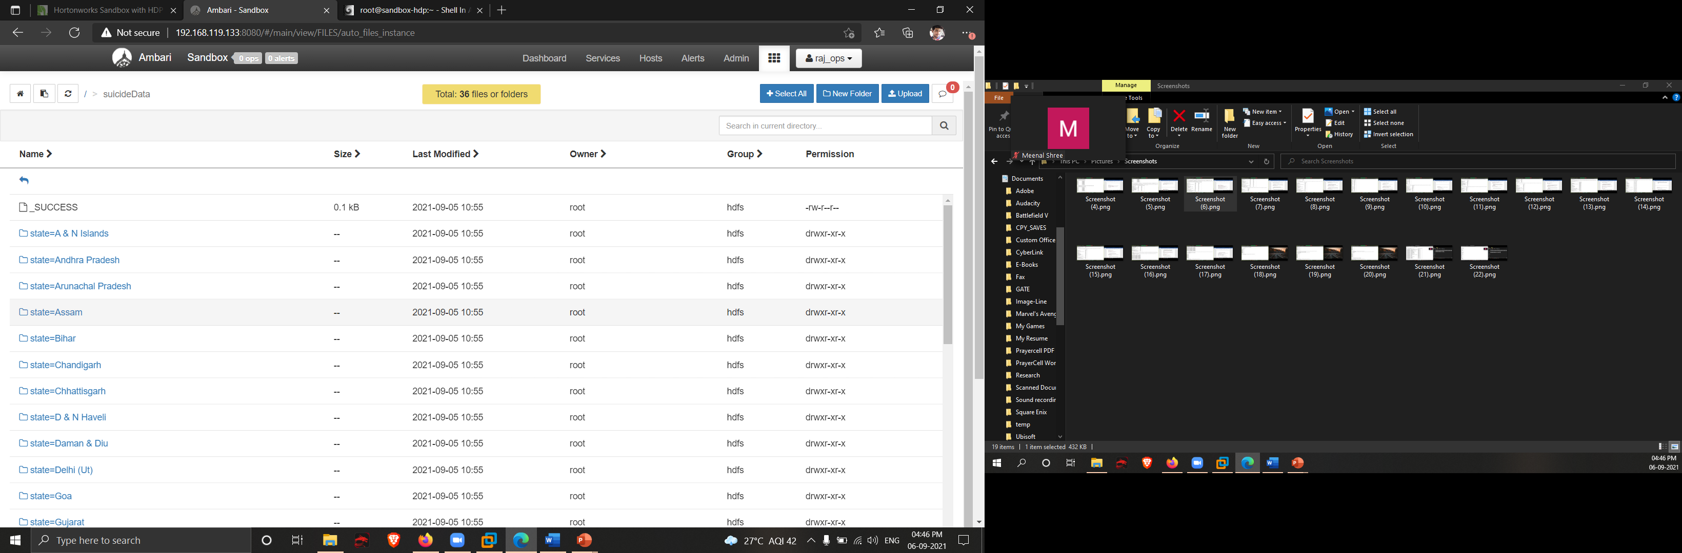
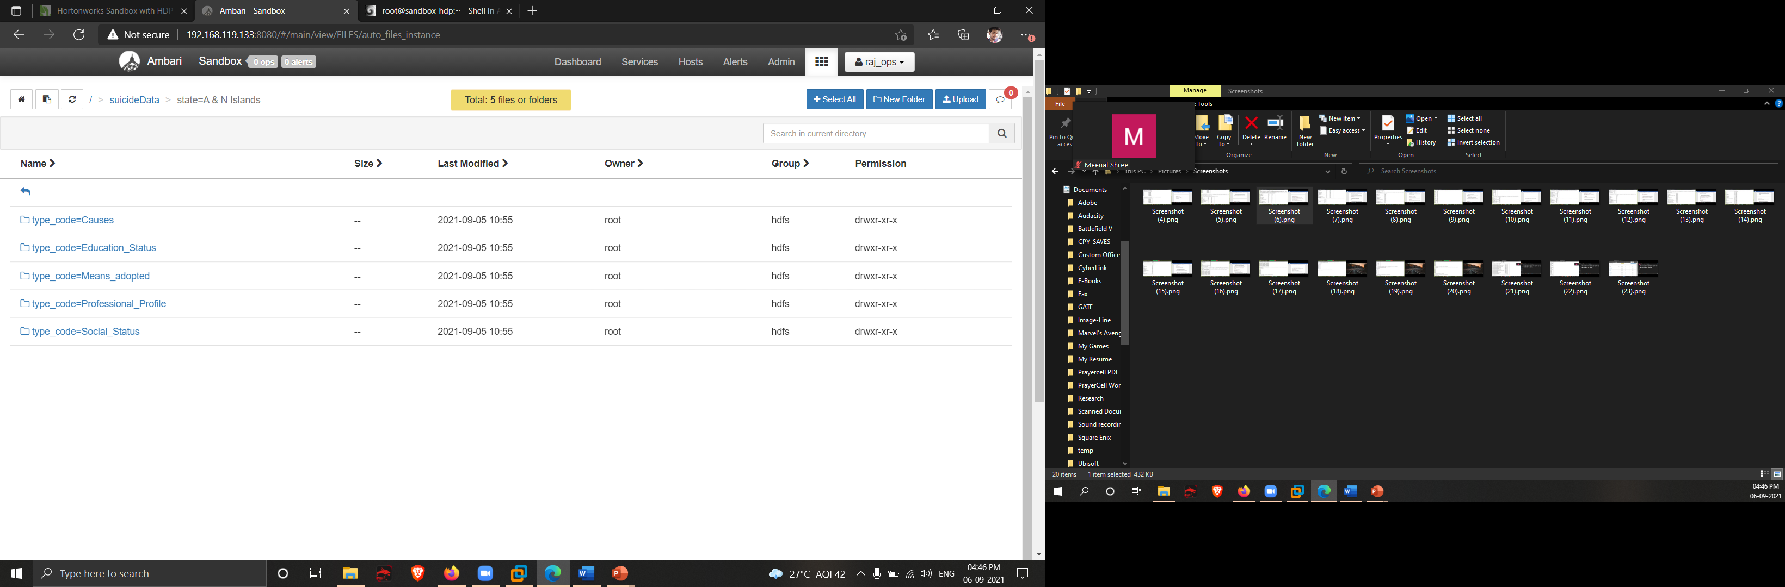
14. Partitioning the data based on state and type_code of suicide
Query: data.write.option("header",True).partitionBy("state","type_code").mode("overwrite").csv("/suicideData")
Explanation:-
Here we are partitioning the dataset stored in the dataframe based on the state and type_code and storing it into the HDFS.

Slide 25
15. Comparing two states based on cause for suicide
Query: MHData = spark.read.options(header='True', inferSchema='True').csv("/suicideData/state=Maharashtra/type_code=Causes/").withColumnRenamed("case_count", "MH Cases")
WBData = spark.read.options(header='True', inferSchema='True').csv("/suicideData/state=West Bengal/type_code=Causes/").withColumnRenamed("case_count", "WB Cases")
outData = MHData.join(WBData,['year','type','gender','age_group'])
outData.groupBy('type').agg(sum("MH Cases").alias("Cases in Maharashtra"), sum("WB Cases").alias("Cases in West Bengal")).orderBy(col("Cases in Maharashtra").desc(),col("Cases in West Bengal").desc()).withColumnRenamed("type","Causes for Suicide").show(50,False)

Slide 26
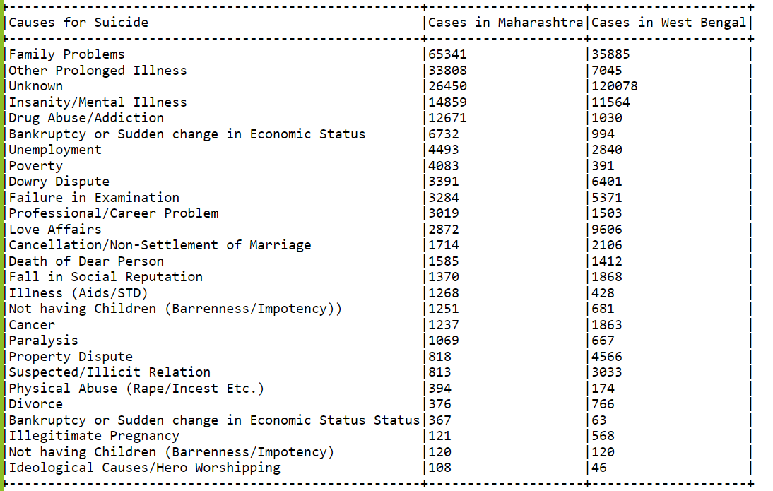
15. Comparing two states based on cause for suicide
Explanation:-
Here we are using the partitions to get the causes for suicides of two states (Maharashtra and West Bengal) to get the total of each cause into a dataframe. Then we joined them on the Cause column and finally displayed the outcome.

Slide 27
16. Partition and comparing two states based on method adopted for suicide
Query: WBData = spark.read.options(header='True', inferSchema='True').csv("/suicideData/state=West Bengal/type_code=Means_adopted/").withColumnRenamed("case_count", "WB Cases")
MHData = spark.read.options(header='True', inferSchema='True').csv("/suicideData/state=Maharashtra/type_code=Means_adopted/").withColumnRenamed("case_count", "MH Cases")
outData = MHData.join(WBData,['year','type','gender','age_group'])
outData.groupBy('type').agg(sum("MH Cases").alias("Cases in Maharashtra"), sum("WB Cases").alias("Cases in West Bengal")).orderBy(col("Cases in Maharashtra").desc(),col("Cases in West Bengal").desc()).withColumnRenamed("type","Means Adopted for Suicide").show(50,False)

Slide 28
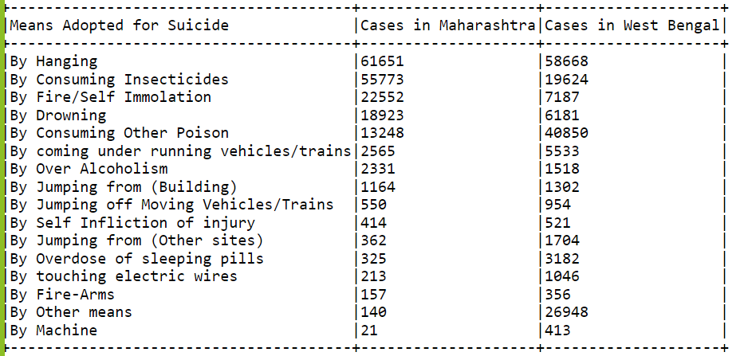
16. Partition and comparing two states based on method adopted for suicide
Explanation:-
Here we are using the partitions to get the means adopted for suicides of two states (Maharashtra and West Bengal) to get the total of each means adopted into a dataframe. Then we joined them on the means adopted column and finally displayed the outcome.

Slide 29
17. Trend of a particular cause between the timeframe along with percentage contribution
Query: totalValue = data.filter(data.type == "Drug Abuse/Addiction").groupBy("year").agg(sum("case_count").alias("TC")).agg(sum("TC")).collect()[0][0]
data.filter(data.type == "Drug Abuse/Addiction").groupBy("year").agg(sum("case_count").alias("TC")).orderBy("year").withColumn("% Share of Total (" +str(totalValue)+ ")",(col("TC")/totalValue)*100).withColumnRenamed("TC", "Drug Abuse/Addiction Cases").show(50,False)

Slide 30
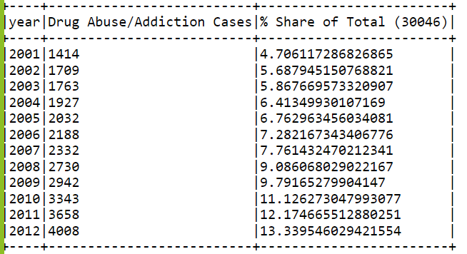
17. Trend of a particular cause between the timeframe along with percentage contribution
Explanation:-
Here we are using trying to find out the trend pattern of a particular cause throughout the whole timeframe. For this particular query the cause was taken as drug abuse/addiction and then we calculate what percentage of the grand total of the cases was contributed by each year to see if it increase or decreased.

Slide 31
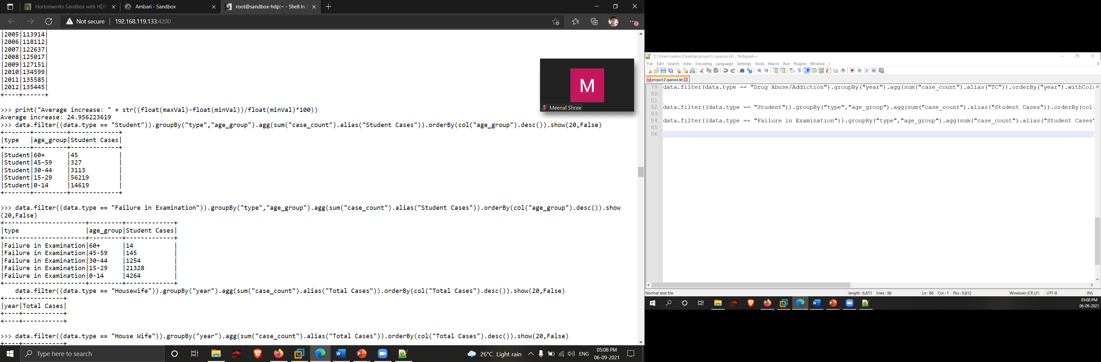
18. Division of suicide cases in various age groups for a profession
Query: data.filter((data.type == "Student")).groupBy("type","age_group").agg(sum("case_count").alias("Student Cases")).orderBy(col("age_group").desc()).show(20,False)
Explanation:-
Using dataframe operations, we are finding out how many suicide cases has occurred in each of the age group for a particular profession (like student).

Slide 32
18. Division of suicide cases in various age groups for a cause of suicide
Query: data.filter((data.type == "Failure in Examination")).groupBy("type","age_group").agg(sum("case_count").alias("Student Cases")).orderBy(col("age_group").desc()).show(20,False)
Explanation:-
Using dataframe operations, we are finding out how many suicide cases has occurred in each of the age group for a particular cause of suicide (like Failure in Examination)

Slide 33
Future Possibilities
We can transfer data to Hive tables if any requirement arrives
We can connect this data to any Web UIs and generate dashboards
And can share these dashboards to schools, NGOs to control death rates

Slide 34
INFERENCE
Maharashtra, West Bengal and Tamil Nadu are the top 3 states with the highest number of suicide cases.
From 2001 to 2012 the suicide cases has increase on an average of 24.95 %.
Men seem to be more vulnerable to commit suicide.
“Family problems” is the major reason for all the suicides irrespective of the gender. Family problems also shows upward trend.
Unknown reasons are highest -- Data collection is not effective enough.
Drug Abuse/Addiction trend is linearly increasing -- More than doubled.
Students of age 15 -29 committed more suicides than students of other age group. Major cause being Failure in Examination.

Slide 35
CONCLUSION
In most of the states, the reason for suicide is “Family Problems”. For that we have come up with the conclusion that: -
families should be more understanding and sensitive towards their family members and should be more supportive towards those members who are facing challenges in their lives, rather than reminding them of their failures and mistakes.
“Maharashtra”, “West Bengal”, “Tamil Nadu” are having highest rate of suicide cases. So, in that case government should be more alert and take necessary steps to reduce the number of suicide case.

Slide 36
CONCLUSION
Another most common reason for suicide is “Insanity/Mental Illness”. In this case we can conclude that: -
Causes: -
The main causes of mental illness include depression, stress, history of abuse, being lonely and isolated and as in our society, people take it wrong when it comes to mental illness because they don’t have much knowledge about it and because of that the victim who are suffering from mental illness use to hide that and it leads to suicide.
Conclusion: -
The society should be more supportive and open-minded so that the victims feel comfortable in discussing their problems and if needed they can consult a psychiatrist without any hesitations.

Slide 37
CONCLUSION
By profession, “House Wife” are the ones that committed most suicides.
Cause: -
Family members don’t support them well, doesn’t respect them and they don’t value them and the work they do. Because of that they feel they are not important to the family. And the main cause is that they don’t respect themselves because of how the society treats them.
Conclusion: -
Every work is equally important and society should value them and respect the work they do and family members should make sure that they should make them feel wanted by treating them well.

Slide 38
CONCLUSION
The cases related to “Drug abuse/addiction” has increased drastically. We can conclude that: -
The government should make more strict laws for drug suppliers and the make sure that the drugs are used only for medical purposes and prevent it from ending up in the wrong hands. Teenagers are the major ones that are affected by this, so parents should be more attentive towards their children.
In this data analysis we have also seen that the more the people were educated the less was the number of suicide cases. So that the government and the society should take up measures to educate the population of the country in the right manner.

Slide 39
Thank you…!

